Slide 1
Central Limit Theorem
- Akshay Amrit

Slide 2
Motivation
Difficult to visualize the phenomenon
Plotting graph repeatedly is tedious
No concrete mathematical proof
Core of Data Science: Make statistical inferences about population data

Slide 3
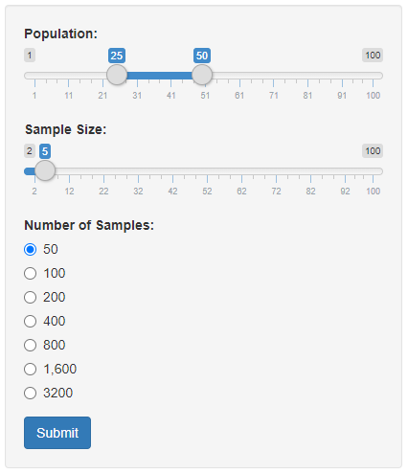
Application
What is Shiny?
Shiny is an R package that makes it easy to build interactive web apps straight from R
Application
GitHub

Slide 4
References
Shiny tutorial - https://shiny.rstudio.com/tutorial/
Developing Data Products (Coursera) – https://www.coursera.org/learn/data-products

